Slide 1
GDP vs Suicide Rates over the Past 30 Years
Group3
-ChungHyun Lee
-Evgeniy Ko
-Tek Acharya

Slide 2
Abstract
Suicide represents about ~1.5% of deaths in the U.S and in the world
Is there a correlation between GDP and suicide rates
K-Means will help us identify subgroups in our data
PCA will help us reduce the dimensionality of our large data set
Linear regression will provide us a regression function

Slide 3
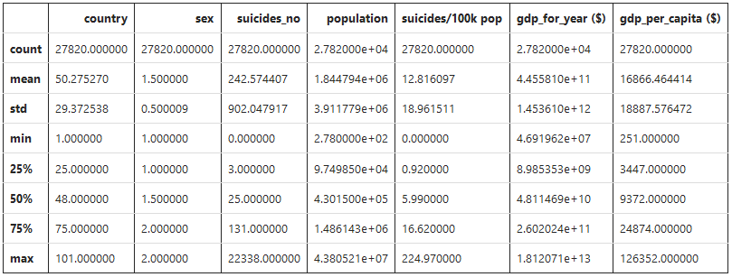
Data set
Suicide rates in 101 different countries, over 30 years
6 categorical variables: country, year, sex, age, country-year, and generation
6 numerical variables: suicide number, population, suicides/100k population, HDI for year, GDP for that year, and GDP per capita **HDI has a lot of missing values**

Slide 4
Predictions
Chunghyun Lee: A strong positive correlation between GDP and suicide rates
Tek Acharya: A strong positive relationship between GDP and suicide rates as country’s economy has direct impact on people’s lives
Evgeniy Ko: A weak correlation between GDP and suicide rates, because there are other factors that effect suicide rates

Slide 5
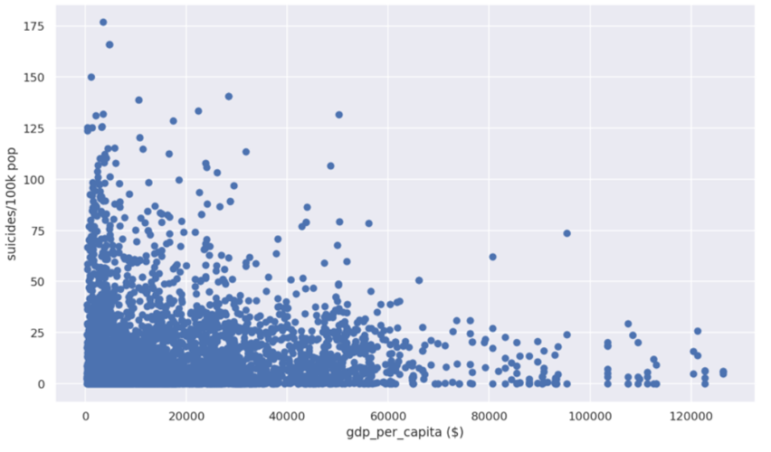
K-Means

Slide 6
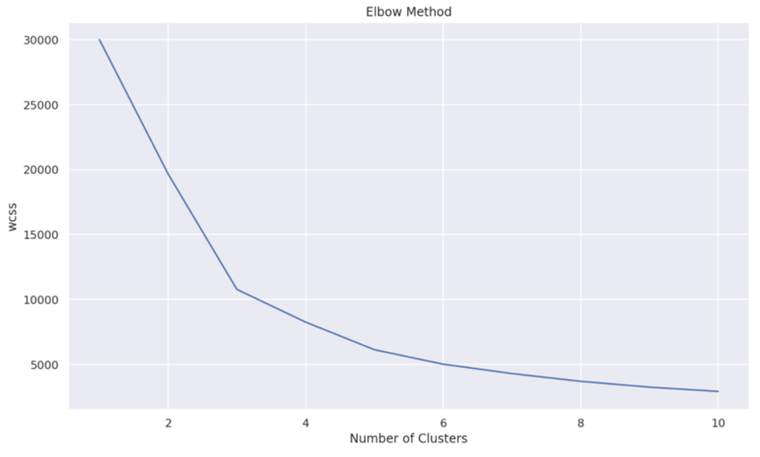
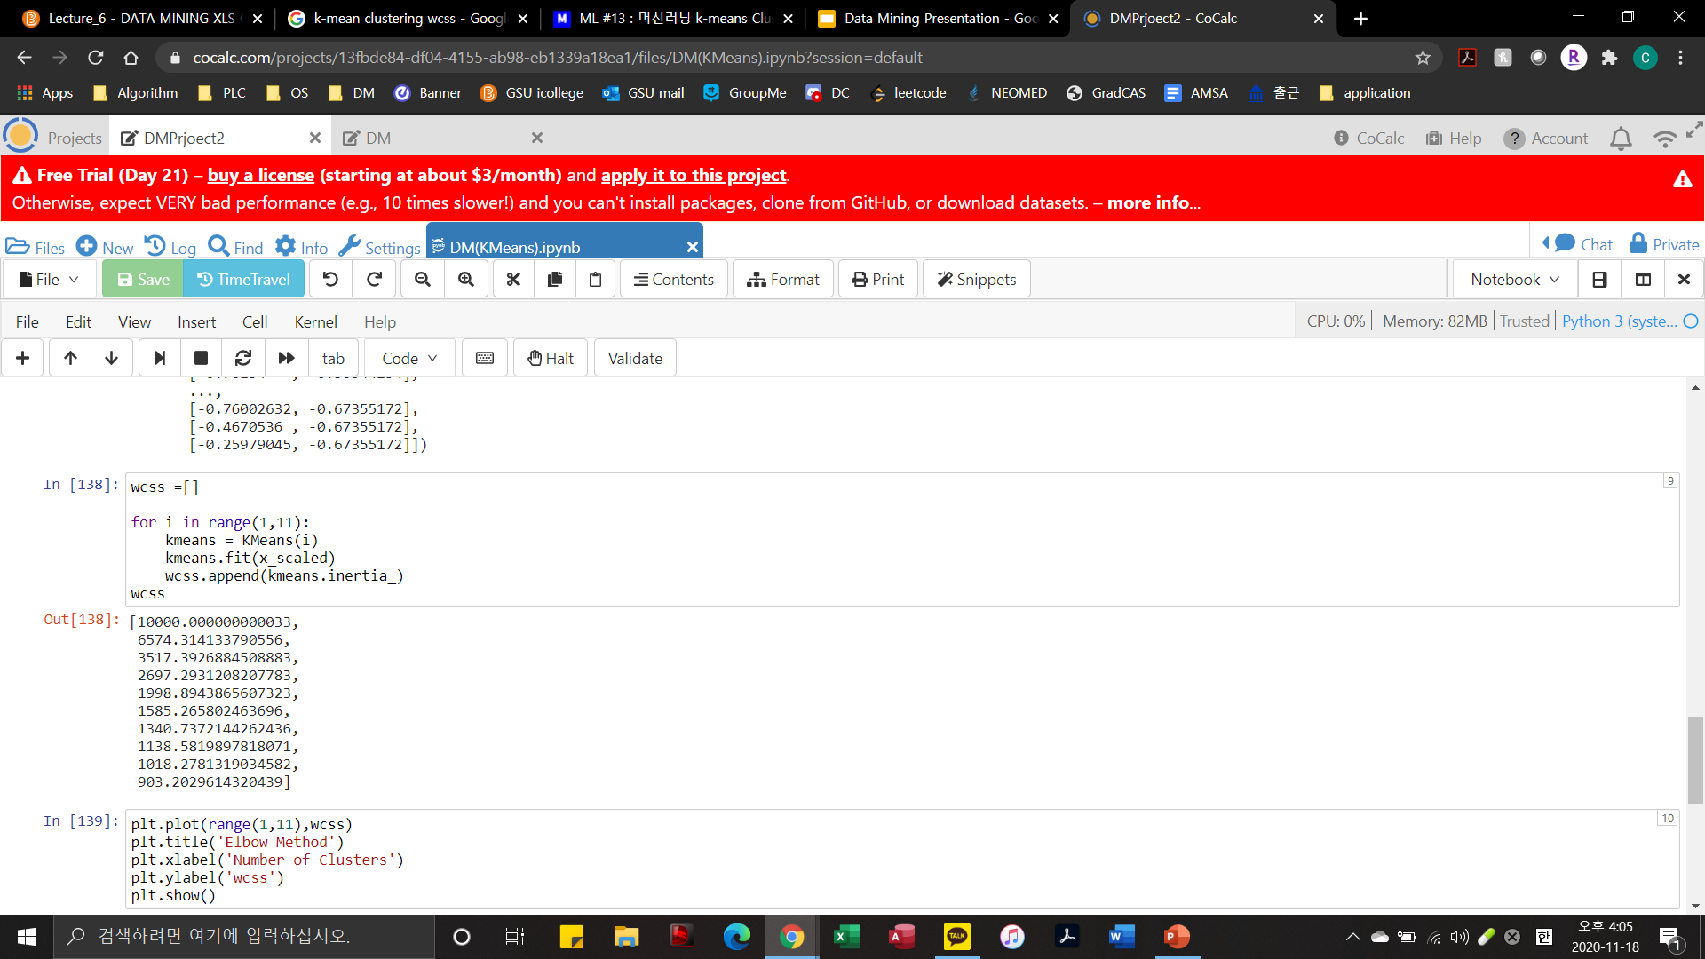
K-Means

Slide 7
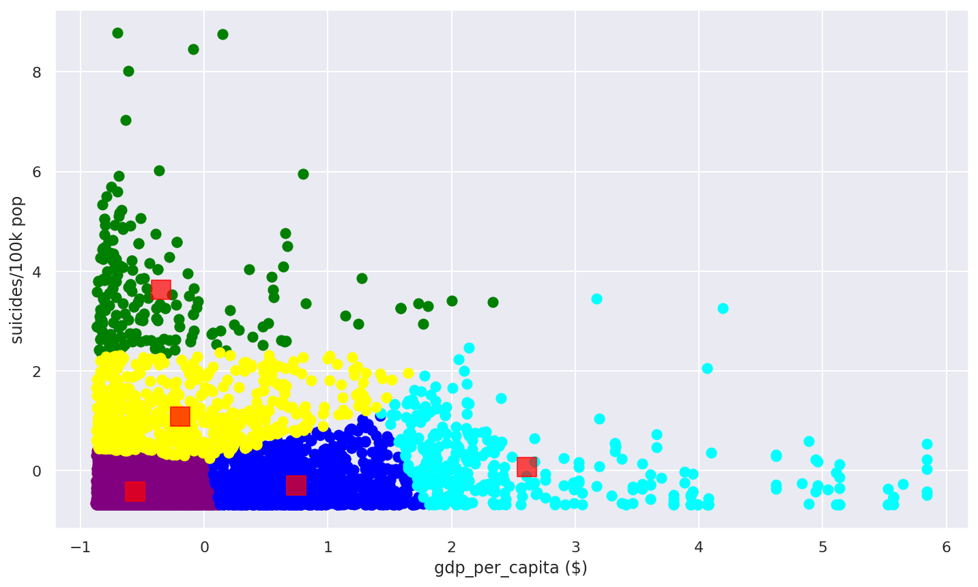
K-Means
K-Means Algorithm Score:

Slide 8
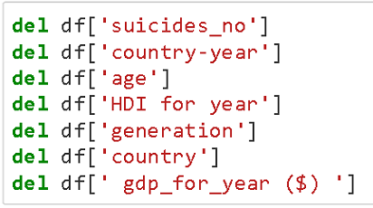


PCA
We decided to go with “Year”, “Population”, “suicide/100k pop” and “gdp_per_capita” as we believed that rest of the features do not contribute to suicide rate.

Slide 9
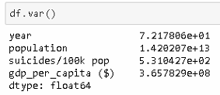
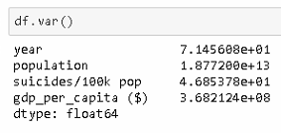
PCA
Male
Female

Slide 10
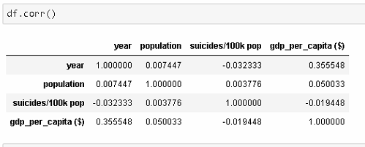
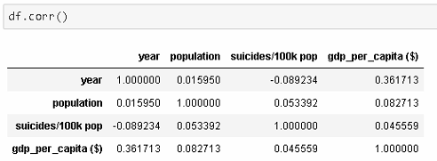
PCA
Male
Female

Slide 11
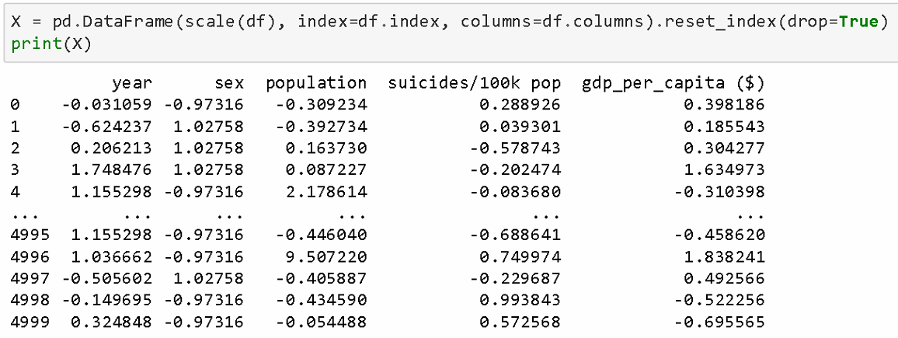
PCA

Slide 12
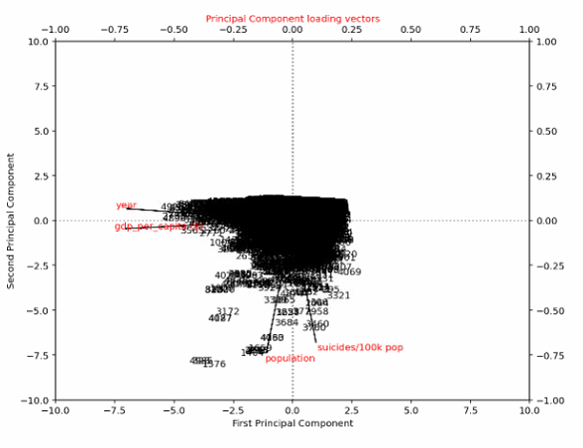
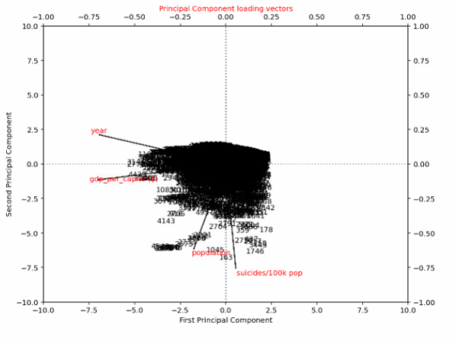
PCA
Looks to us that the PCA (plot) for both male and female to be very similar where PC1 carries little more information to that of PC2
Male
Female

Slide 13


PCA
Male
The PC1 explained: 34.09%
The PC2 explained: 25.14%
Female
PC1 explained: 34.40%
PC2 explained: 26.90%

Slide 14
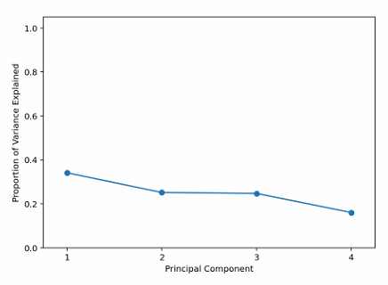
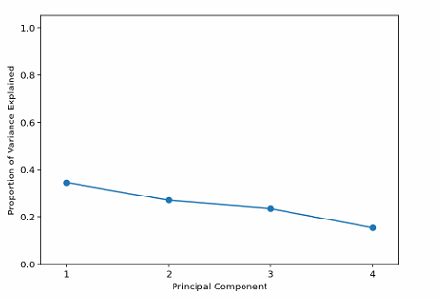
PCA
Male
Female

Slide 15
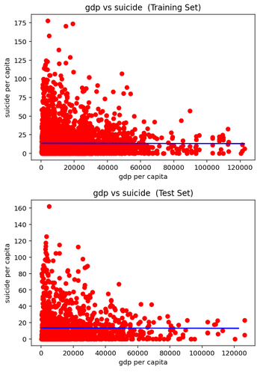

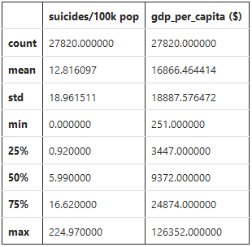
Linear Regression
For the first model, we performed the algorithm on a sample, n=5000, of the original data set.
Model’s Coefficient
Model’s Intercept
R-Squared

Slide 16
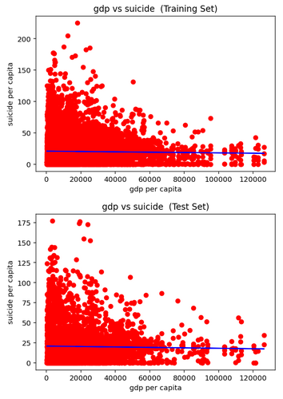

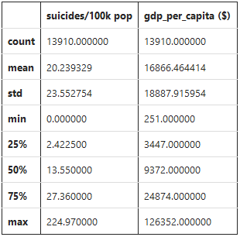
Male Linear Regression
Male suicide rates data set information
Model’s Coefficient
Model’s Intercept
R-Squared

Slide 17
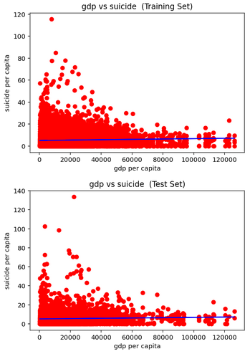

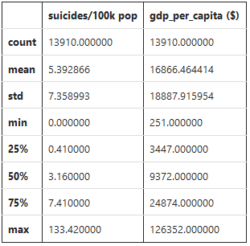
Female Linear Regression
Female suicide rates data set information
Model’s Coefficient
Model’s Intercept
R-Squared

Slide 18
Linear Regression Algorithm Results
Countries with less than $20000 GDP represents 70% of our dataset.
No significant change in suicide rates as GDP increases
Men have a greater suicide rate than women

Slide 19
Resources
https://www.kaggle.com/russellyates88/suicide-rates-overview-1985-to-2016
https://www.fastcompany.com/90349777/gender-inequity-costs-the-united-states-2-trillion-in-lost-gdp
https://ourworldindata.org/suicide
https://www.who.int/teams/mental-health-and-substance-use/suicide-data
https://databank.worldbank.org/source/world-development-indicators

Slide 20
Any Questions?

